Slide 1
Stock Market Trend Prediction Using Natural Language Processing
Neetika Sharma
Roll /Reg. No. 02BTD5050034
CSE 8th Sem

Slide 2
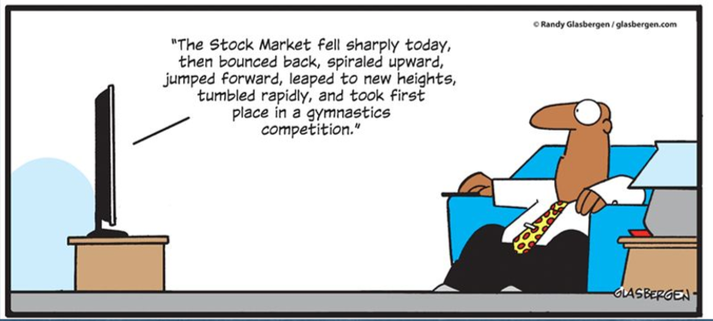
Introduction
NLP: Attempting to discover patterns and ability to manipulate the human language by a computer.
Stock Market Prediction is one of the most famously researched areas that takes the help of Machine Learning to predict the rise and fall of a stock based on past data.

Slide 3
Data Science Life Cycle
Data Collection
Data Preparation
Exploratory Data Analysis
Modelling
Model Evaluation
Model Deployment
Business Understanding

Slide 4
Datasets:
The data set in consideration is a combination of the World News , stock price shifts available on Kaggle and particular data extracted from static images (video)
There are 25 columns of top news headlines for each day in the data frame.
Data ranges from 2008 to 2016 and the data from 2000 to 2008 was scrapped from Yahoo finance.
Labels are based on the Dow Jones Industrial Average stock index.
Class 1-> the stock price increased.
Class 0-> the stock stayed the same or decreased.

Slide 5
Data Wrangling
Cleaning of data.
Combine all the top 25 News headlines into one single list of words per day.
The Data has been Processed!

Slide 6
Words -> Vectors
CountVectorizer helps to tokenize and determine the frequency of the words.
Then fit_transfoem is applied on the above object to obtain a sparse matrix of words counts.

Slide 7
Model Accuracy
 | Accuracy (In %)
Model | 1 gram | Bi-gram | Tri-gram
Logistic Regression | 82.275 | 85.714 | 85.185
Random Forest | 84.656 | 85.978 | 85.185
SVM (Linear Kernel) | 82.275 | 84.656 | 84.656
SVM (Gaussian Kernel) | 85.185 | 85.185 | 82.539
Naïve Bayes | 82.010 | NaN | NaN

Slide 8
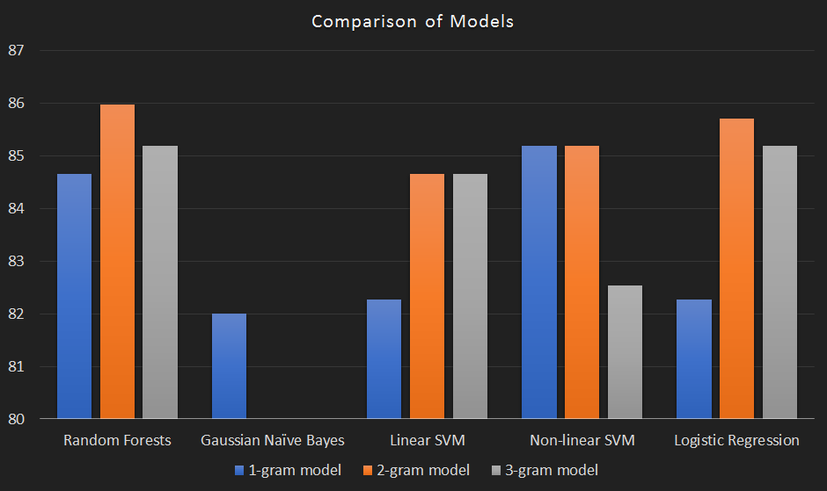

Slide 9
Conclusion
Random Forest had highest accuracy on the a bi-gram model as shown on the chart. The prediction accuracy was 85.97%
Using NLP techniques, we were able to accurately predict the stock market trends 85% of the time.

Slide 10
Queries?

